Slide 1

Please sit at a table in groups of 4 or 5.

Slide 2
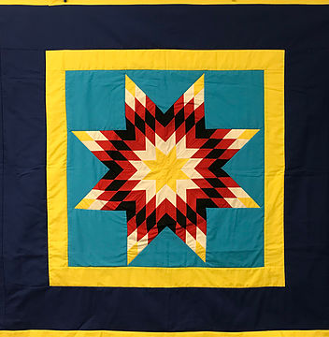
What’s in a Name? Fostering a Sense of Belonging Through the Wonder of Names.
Katie Jardine

Slide 3
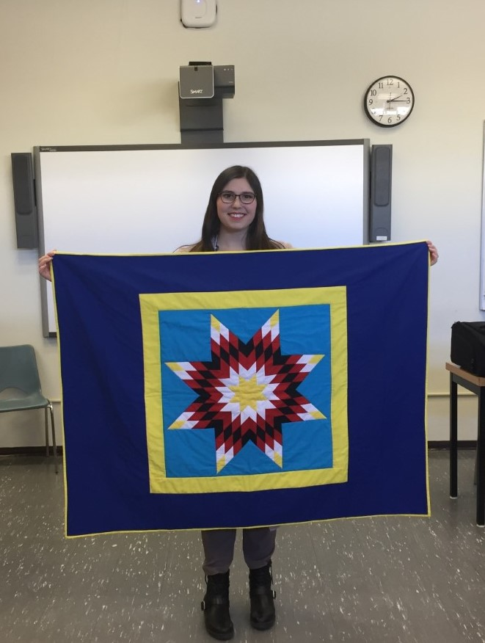
Who am I? Why does this work matter?
Humanities and Band Specialist
Background in ELA, History and Music.
Thesis
Research traditions and identity.

Slide 4

Hopes and Goals
Give you ideas on how identity and citizenship can be tackled for the 21st Century Learner.
Share some resources with you to help explore identity as fluid and complex and foster a sense of belonging in your classroom.
Explore some of the theory and history surrounding this project and pedagogical approaches to encourage wonder in your classroom.

Slide 5
The Plan:
Part I: Wonderments and Name Giving (40-50 mins)
(5 minute Movement/Brain Break)
Part II: Creating a Praxis (The Pedagogy and Name Exploration) (30-40 mins)
(5 minute Movement/Brain Break)
Part III: Star Quilts A Fascinating Tradition (30-40 mins)
(5 Minute Break)
Part IV: Building Community (Creating our Diamonds, Time to Explore Resources and Final Reflections) (25-30 mins)
Have a great weekend!

Slide 6

Part I: Wonderments and Name Giving (40-50 mins)

Slide 7
Personal Book of
Wonder
“It is possible for us to meet this world and the other subjects which make up this world and to stand face to face with them- to feel wonder, amazement and a sense of mystery.”
(Huebener)
Notes:
I

Slide 8

FIRST……In the clouds below write ideas, answers or thoughts about the following questions. Note there are no right or wrong answers.
What do I know about my name?
What do I know about how I got my name?

Slide 9
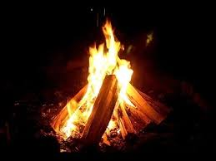
It’s story time…

Slide 10
Now…… Create at least 3-5 questions you have relating to any of the following words or topics. You also may come up with other questions that involve other words or topics relating to names or the story we just read
Name Giving Names Birth
History Heritage Identity
Me Them Us
Citizen Tradition Community
Belonging Inclusion

Slide 11

Read the short poem “To No One In Particular.” Circle, highlight or underline words or phrases that stand out to you. Include a reason why this word or phrase stood out to you.

Slide 12
Wonder:
Wonder (verb)- means to be fixated or fascinated with or by something (usually a person, place or thing) or to be curious about something.
Wonder (noun)- a feeling of surprise mingled with admiration, caused by something beautiful, unexpected, unfamiliar, or inexplicable.

Slide 13
FINALLY…..Think back to the questions you created and the ideas, thoughts, or words that stood out to you today. See if you can create 4 I wonder statement.
I wonder…..

Slide 14

Next….
Step 1: Pick one of your I wonder statements and write it on one of the blue pieces of paper at your table.
Step 2: Give your blue pieces of paper to a different table.

Slide 15
Step 3: Open the envelope at your table. Inside you will find I wonder statements students came up with from completing this same wonder book activity.
Step 4: Look at the student questions and see if there are any that are similar to the adult created questions (ones on the blue sheets of paper). Work in your table groups to place similar or like questions into piles and provide a reason as to why you are grouping them together.

Slide 16
Finally…
Step 5: Individually pick one of the student questions (questions on white paper) that speaks to you. Come up with a response to the question that still allows the topic to be ‘in play’ or open for further investigation. (You may write your answer underneath the question.)

Slide 17
Share with out with your table group….
Which question did you choose? Why?
How did you respond? Why?
How do you see your response keeping the topic ‘in play’ or open for further investigation?

Slide 18
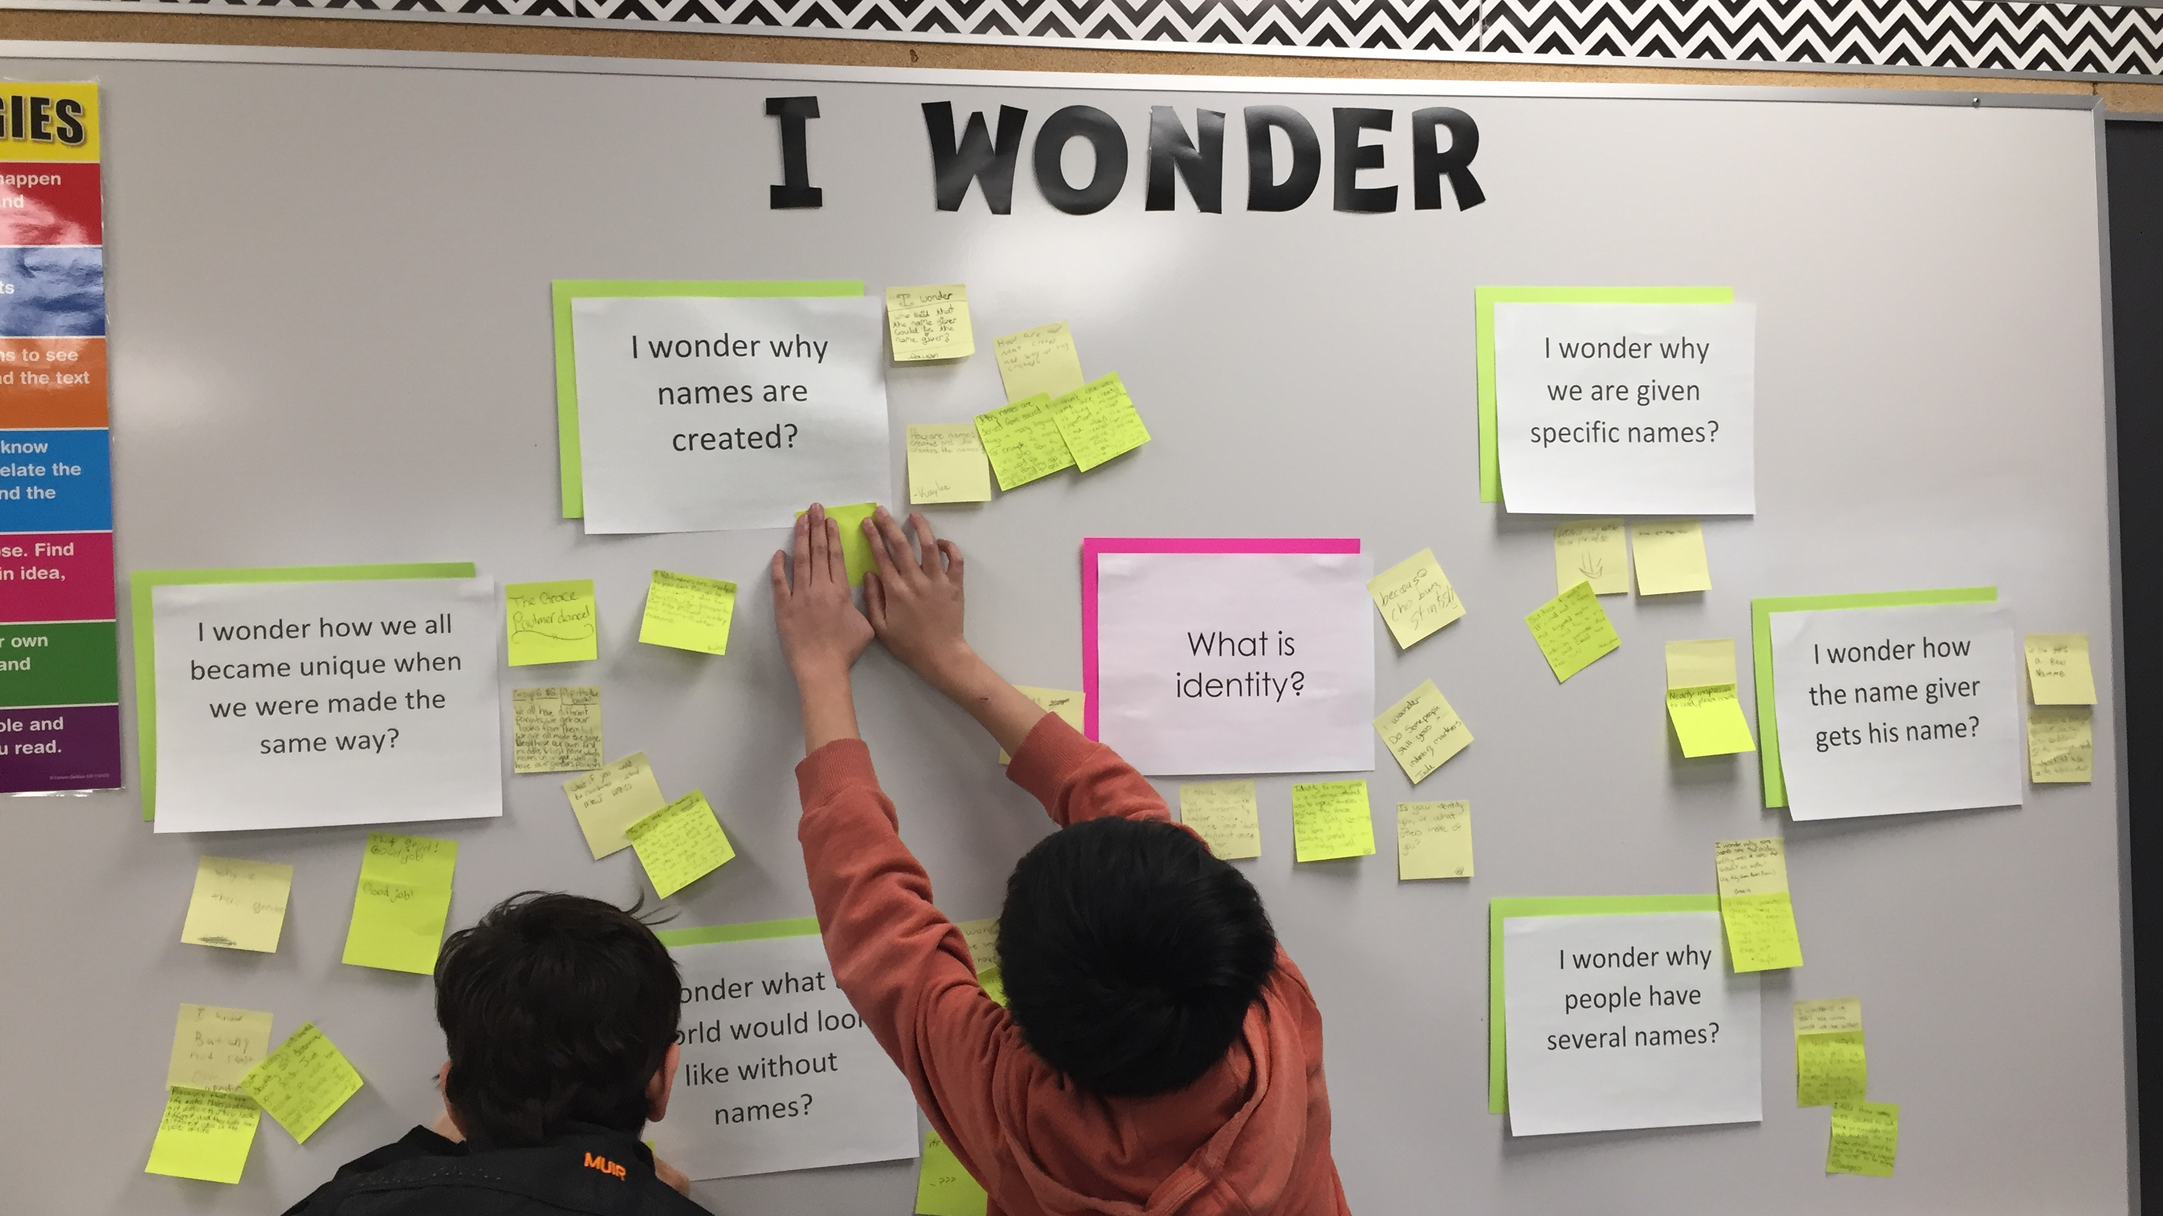

Slide 19
5 Minute Brain and Movement Break

Slide 20
Part II: Creating a Praxis (The Pedagogy and Name Exploration) (30-40 mins)

Slide 21
Who am I? (As a teacher I am…. )
Step 1: Take 5 yellow post-it notes.
Step 2: Write words that you feel describe your professional identity on your 5 post-its.
Step 3: Post them in front of you in line.

Slide 22
Individually read the article “Working from Within” by William Pinar
Complete the 3:2:1 as you read.
Feel free to mark up and highlight your article.
You will have 10-15 mins.

Slide 23
In your table groups share out your thinking (3:2:1) about this article…..
What stood out to you?
What questions do you still have?
What did you find motivating or bothersome about this article?

Slide 24

Post-it’s Part II:
Step 4: Take 5 more post-its in a different colour.
Step 5: Write 5 things that are who you are on a personal level. (I am….) These should represent your private or personal identity.

Slide 25
Challenge:
If students give you challenging or difficult questions, what would you be willing to offer student or reveal to them about who you are as a person?
Step 6: Group post-it notes together that you would be willing to reveal or share with students during the learning journey surrounding identity and community without hesitation. Use your graphic organizer template to help organize your thinking.

Slide 26
Journeying
The etymology of the word Journeying means “daily work.” “In a sense everybody is always on a journey.” (pp. 1)
“The most basic purpose of going on a journey, then, is the very ordinary one of learning to be at home in a more creative way, in a good way, a healthy way, a way tuned to the deepest truth of things.” (pp. 2)
.”… undertaking a journey can be a collective enterprise as much as an individual one. In either case, though, what is involved is learning how to understand one’s own traditions with greater insight and creativity, one’s cultural heritage…” (pp. 2)

Slide 27
Curricular Implications
Social studies is the study of people in relation to each other and to their world. (Alberta, POS)
“Social studies helps students develop their sense of self and community, encouraging them to affirm their place as citizens in an inclusive, democratic society.” (Alberta, POS)

Slide 28
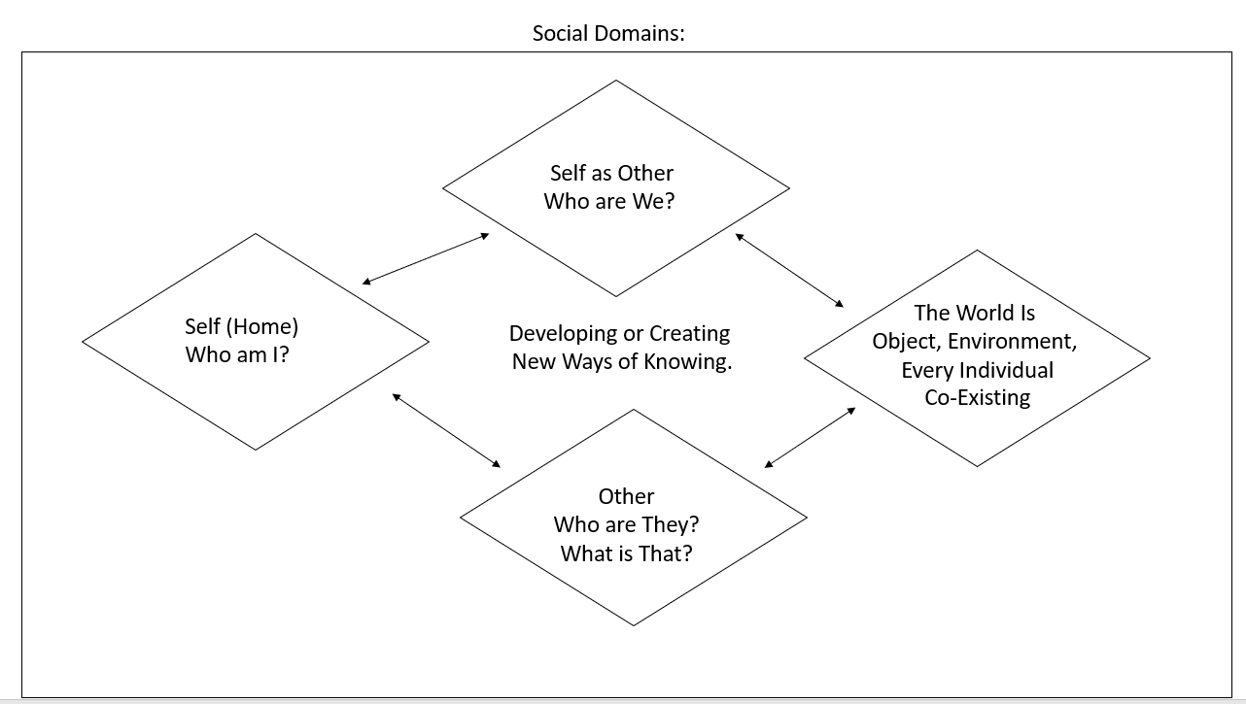

Slide 29
5 Minute Brain Break

Slide 30
Part III: Star Quilts A Fascinating Tradition
Go to www. Names.org and look up the following things and write it on a post-it:
1) What does your name mean?
2) According to the website, is your name historically considered a gender neutral name, a female name or a male name?
3) Is your name more popular as a first name or a last name?

Slide 31
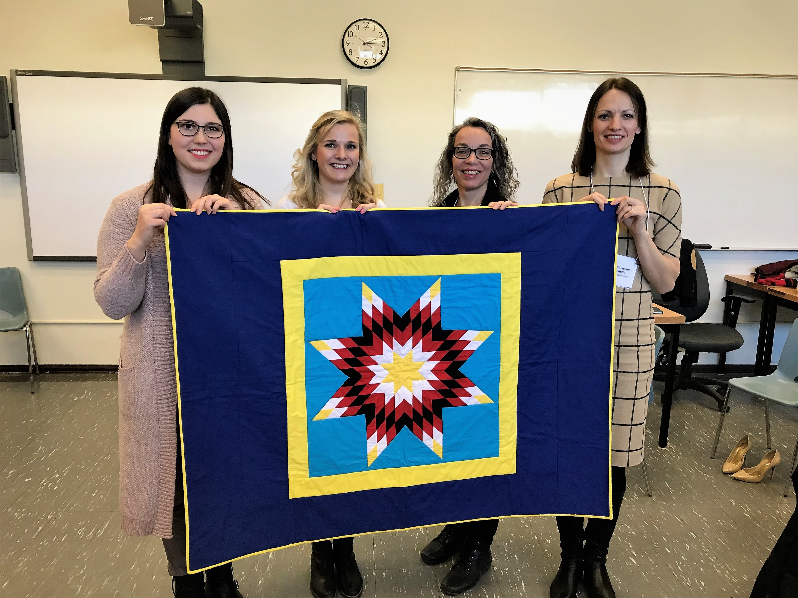
Where the journey began..
Brandon University
Star Quilt Research Project -> Transferring this work into my classroom.

Slide 33
History of the Star Quilt in A Nut Shell
European missionaries in the late eighteenth century introduced quilting to First Nations
The Dakota/Lakota would take large pieces of “fabric” which originally were buffalo hide. The hides would be stitched together with bone and sinew.
Buffalo was the main source of material to make blankets because of its importance to the Plains peoples. The buffalo is a spiritual animal and has a long history with the Plains Indians tribes. Lakota People’s believed that the buffalo was the “embodiment of solar power”
Believing that the Buffalo is a spiritual animal there are many stories told around the buffalo and connecting it to the Star Blanket in particular.

Slide 34
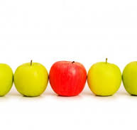
Read the Star Quilt Story at Your Table
What was 1 idea or phrase that stood out to you in the story?

Slide 35
The Star blanket is used in an honouring and protection ceremonies because the symbol of the morning star represents the beginning of new day/another day of life given by the creator [10].
Star quilts are always gifted. ​

Slide 36
5 minute brain break

Slide 37
Part IV: Creating A Star Quilt
Step 1: Fill out your identity Web
Step 2: Create a rough draft of your diamond.
Step 3: Create your final copy of your diamond.
Step 4: Reflect on your diamond and how it represents you.
Step 5: Share your diamond with someone else and explain how it represents who you are and what you bring to the learning community.
Step 6: Piecing the Quilt Together.

Slide 38
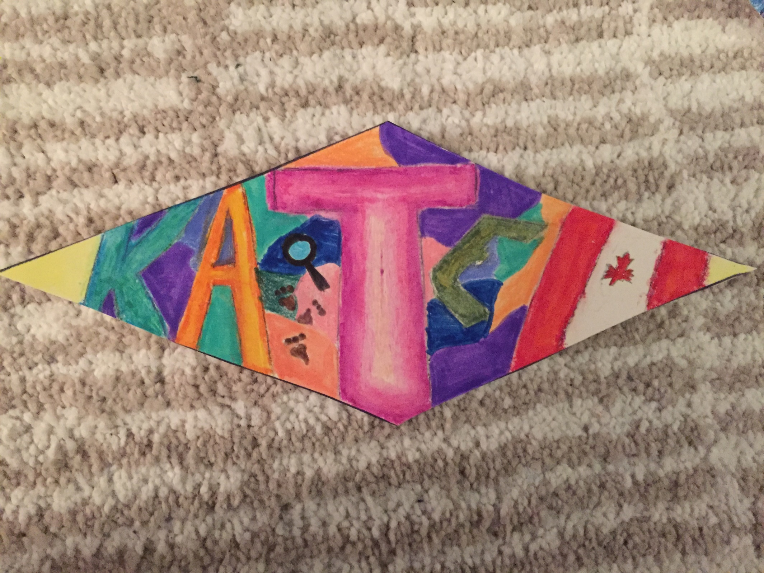
You will be creating a piece of a quilt. Your piece of the quilt has to represent who you are.
Elements on the diamond:
-Name
-Canadian Flag: represents Kate’s love of Canadian history and the fact that she is Canadian.
-Paw Prints: represents her love of animals.
-Magnified Glass: represents her love of mysteries
- Different shapes and colours: represents her playful nature.

Slide 39
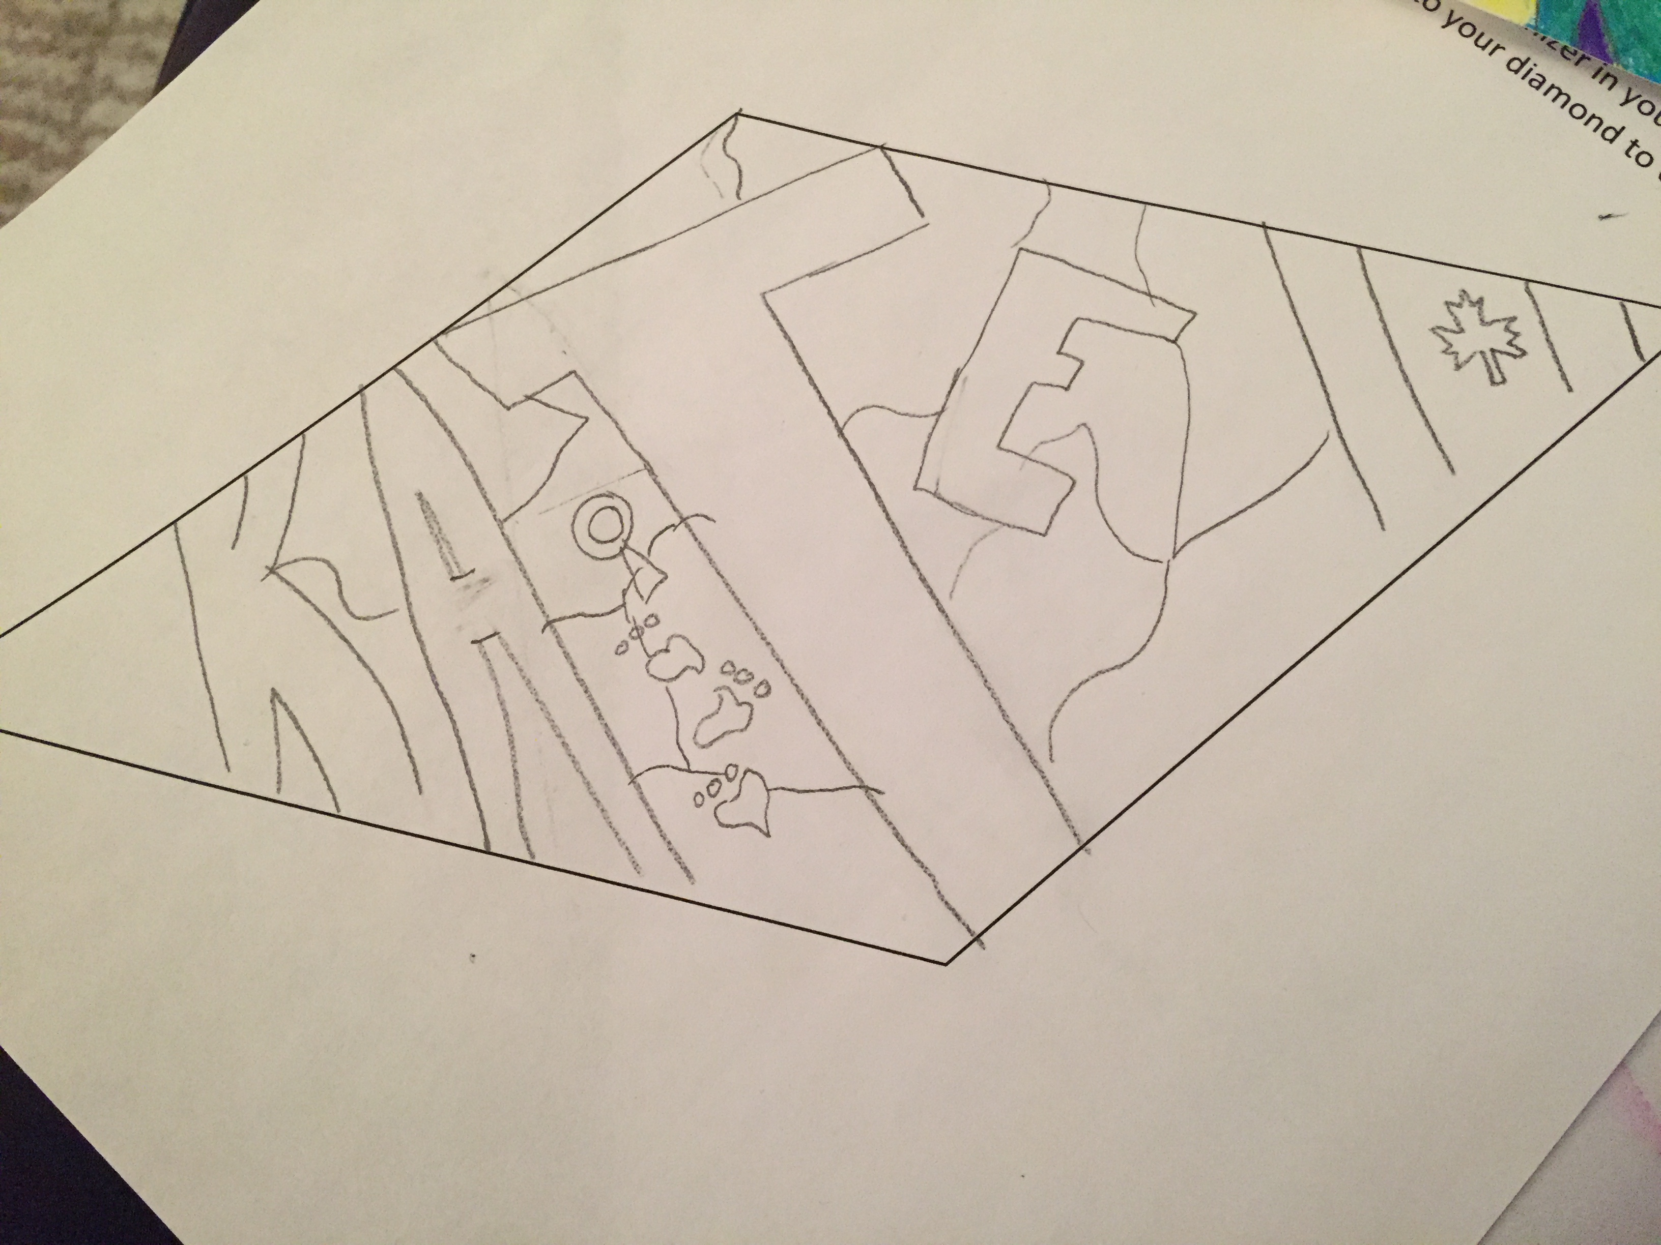
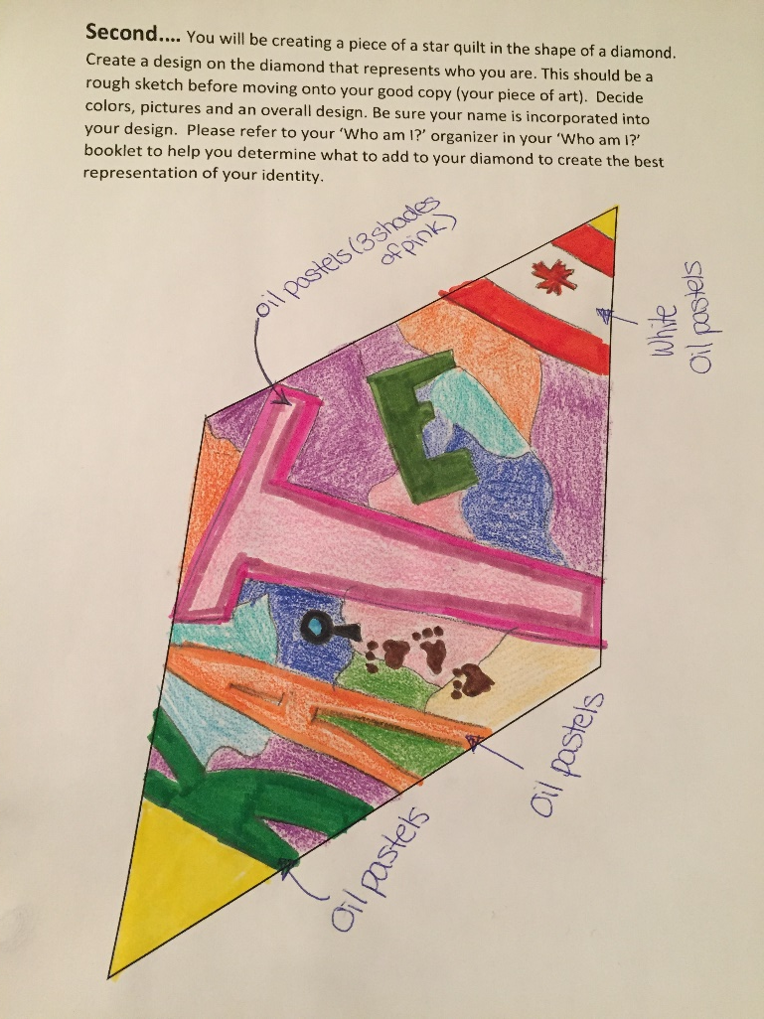
Step 1:
Creating a rough design. Start with a pencil drawing and then add colour.

Slide 40

Final/ Good Copy of Diamond Design
Show Miss J your rough draft of your diamond.
Receive a card stock diamond. Decorate the card stock diamond to create your good/final copy.

Slide 41
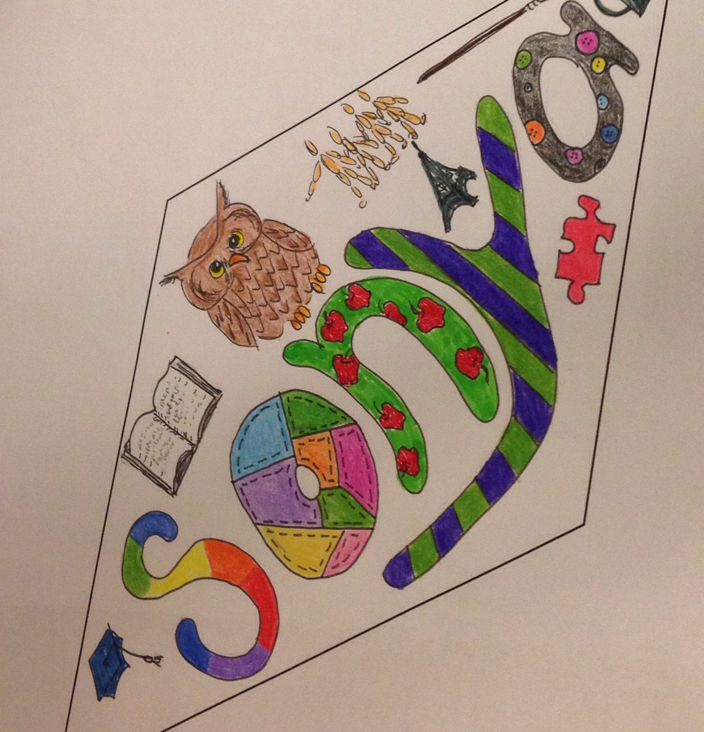
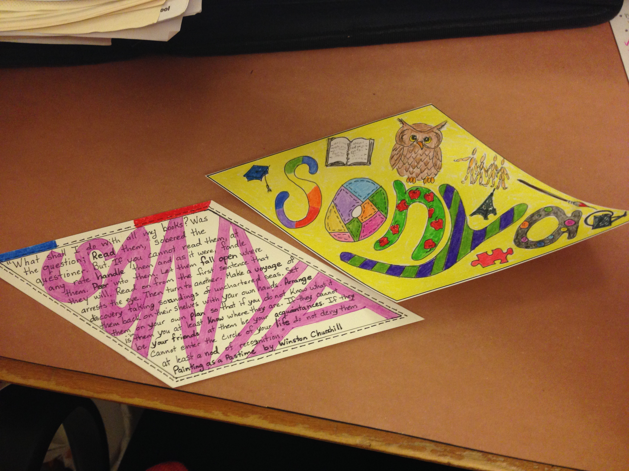

Slide 42

Written Response
It is time to explain your diamond and how it represents your identity.
Explain each element on your diamond and your design choices (including color)
If you do not know how to get started there is a writing prompt for you to use/fill in.

Slide 43
Share your diamond with your table group and determine what unique thing each of you bring to your community.

Slide 44
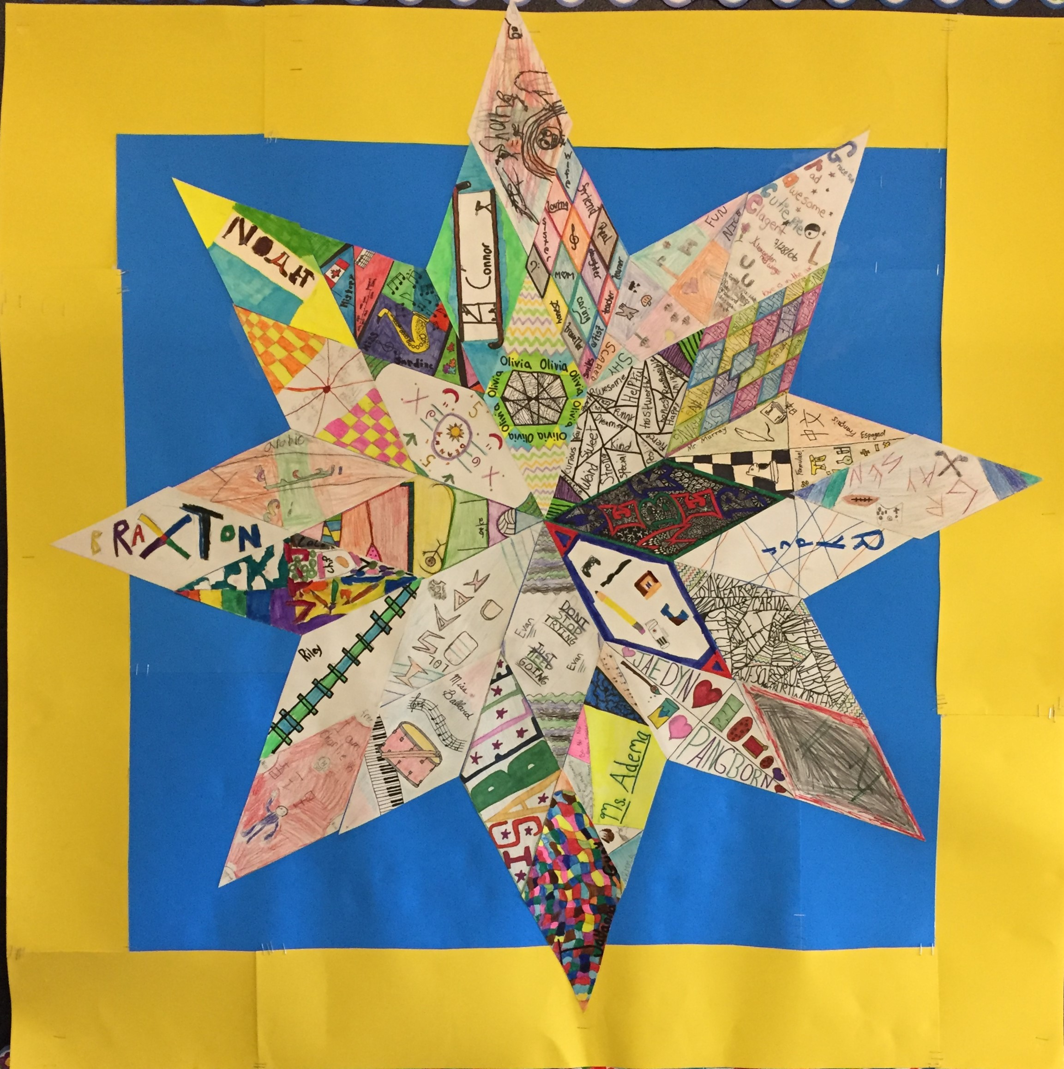
Piecing the Quilt Together
Have students gather around one common area
One by one ask students to place the diamond on the backing of poster board paper.
Glue or tape the diamond pieces down.

Slide 45
https://elenigal33.wixsite.com/thestarquiltproject Password: TAS2017

Slide 46
What is a name?
What is in a name?

Slide 47
Where did each activity we do today fall on the road map?

Slide 48
Give you some time to explore the handouts and resources available:
Go to katelynjardine.com
Click on Samples of Work -> 2020 What’s in a Name? Resources.
Katelynjardine.com -> Samples of Work -> Star Quilt Project
Katelynjardine.com -> Samples of Work-> Wonder Boards
https://elenigal33.wixsite.com/thestarquiltproject Password: TAS2017

Slide 49
Jardine, K. (2018). Fostering a Sense of Belonging Through the Wonder of Names.
Education Canada Magazine.
Manitoba Government. Arts Education POS. (2011). Retrieved from https://www.edu.gov.mb.ca/k12/cur/arts/visual/framework_k-8.html
Manitoba Education. (2003). Integrating Aboriginal Perspectives into Curricula.
Retrieved from http://www.edu.gov.mb.ca/k12/docs/policy/abpersp/ab_persp.pdf
Manitoba Education and Training. Indigenous Education. Incorporating Aboriginal Perspectives:
A Theme-Based Curricular Approach. Retrieved from: http://www.edu.gov.mb.ca/k12/abedu/perspectives/index.html
Manitoba Government. Social Studies POS. (2007) Grade 9 Social Studies Overview (pg 1-23)
Retrieved from: http://www.edu.gov.mb.ca/k12/cur/socstud/foundation_gr9/overview1.pdf
Our Words, Our Ways - Alberta Education. (2011).
Retrieved from: https://education.alberta.ca/media/3615876/our-words-our-ways.pdf

Slide 50
The Guardian. Names Really Do Matter. (2017, April 29) Retrieved from:
https://www.theguardian.com/science/2007/apr/29/theobserversuknewspages.uknews
Aoki, Ted. T. (2012). Layered Voices of Teaching The Uncannily Correct and the Elusively True ( 1992) In W. Pinar &
R. Irwin (Ed). Curriculum in A New Key. New York, NY: Routledge

